Slide 1

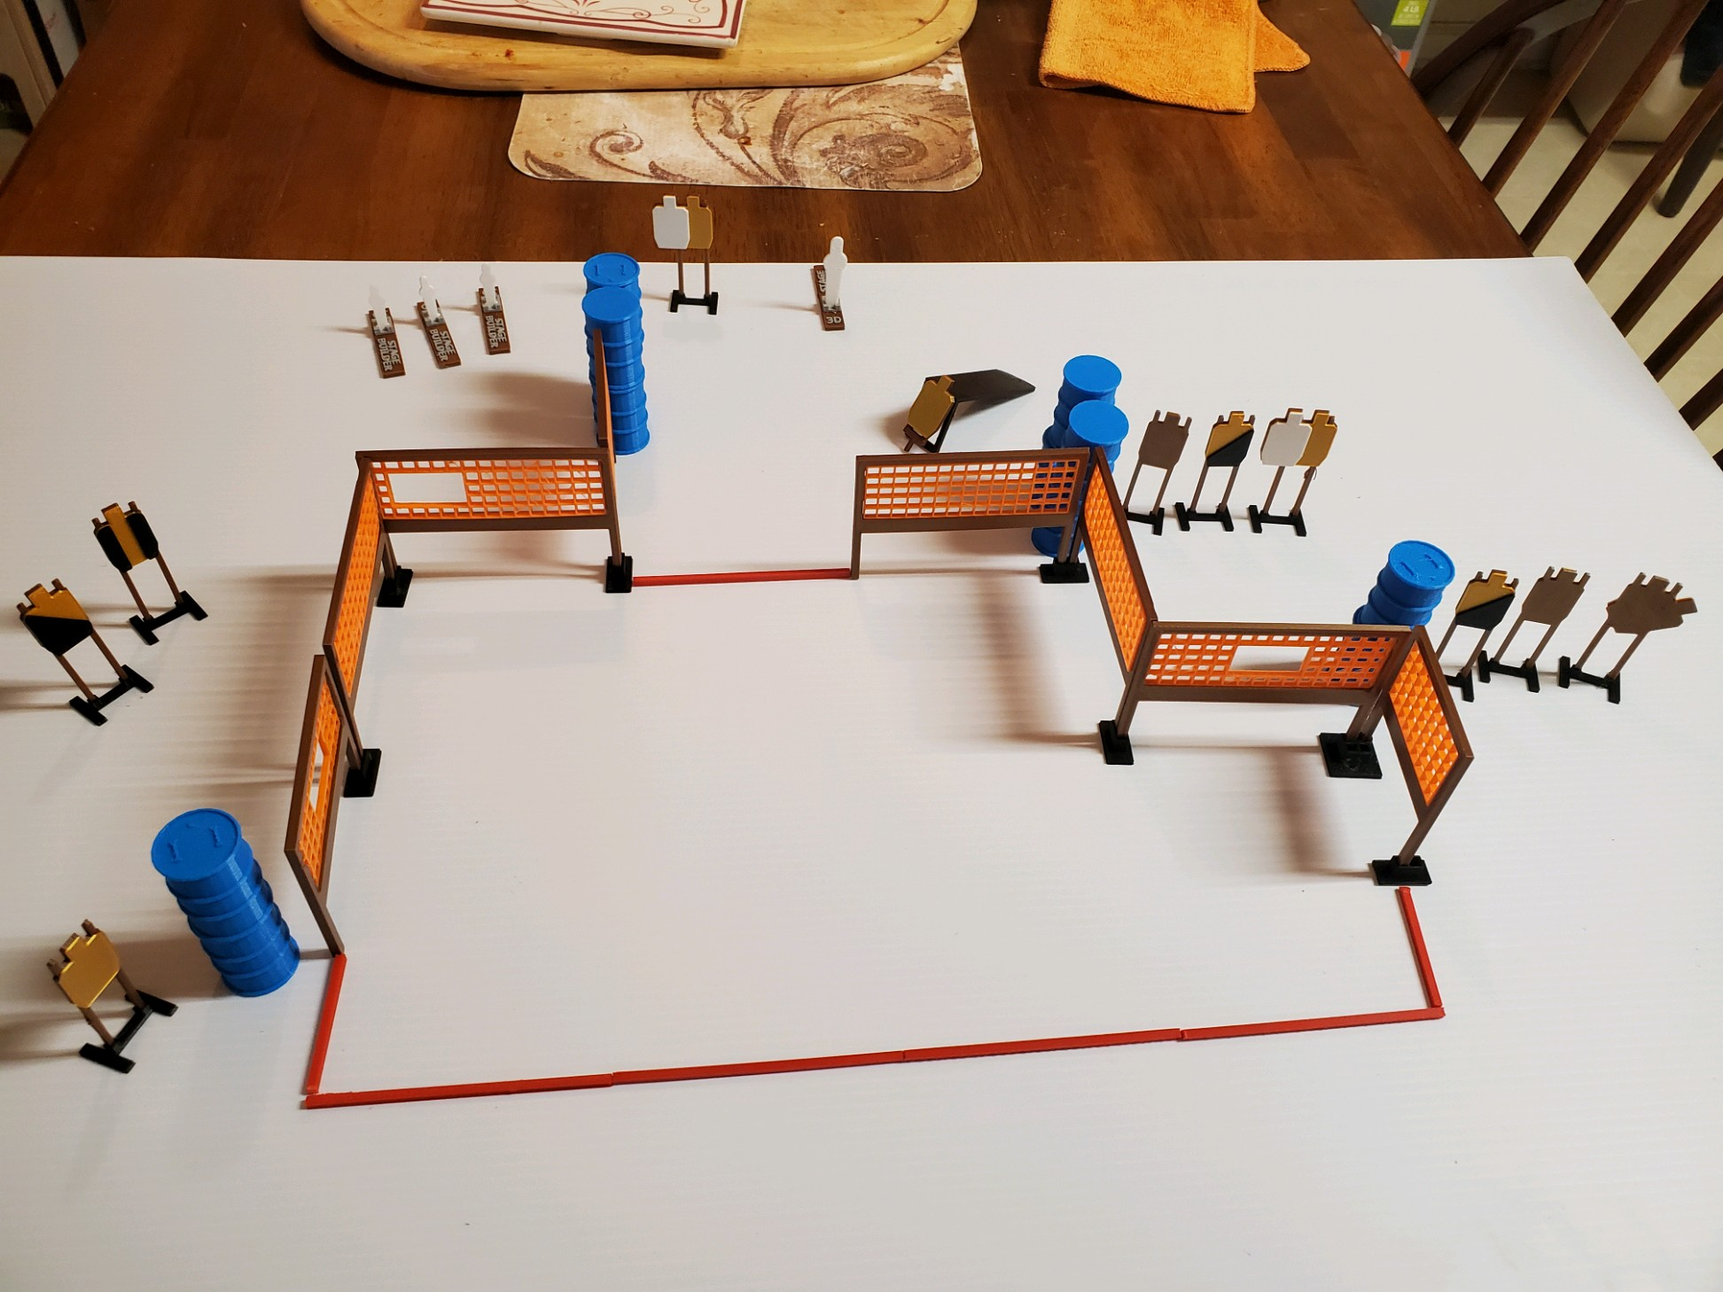
 | Dothan Practical Shooters – USPSA Match Don’t Step Too Far Course Designer : Jerry Copeland Bay: A3
Round Count 26 rounds 11 IPSC 3 minis, 1 fall forward popper
Equipment List Max trap 10 wall feet Max trap + activator

Slide 2
Don’t Step Too Far
Written Stage Briefing
Scoring: Comstock Rounds: 26
Targets: 11 IPSC, 4 steel
Handgun start position: anywhere inside the shooting area, wrists below belt. Handgun is loaded and holstered.
PCC start position: anywhere inside the shooting area, stock on belt. Loaded carbine is held with both hands, safety on.
Stage Procedure: on the audible start signal, engage target as they become available from within the shooting area. The max trap is activated by P4 and remains visible at rest.

